Slide 1
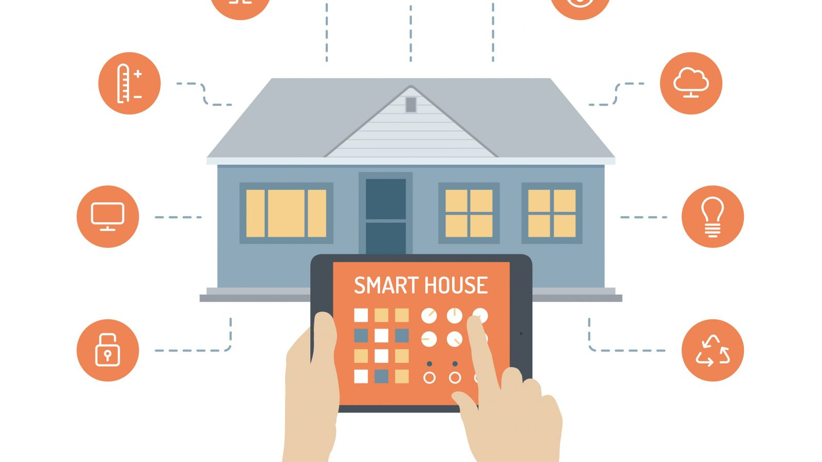
Smart Home Project Embedded systems
Presented by: Ibrahim Tarek
Presented to: AMIT

Slide 2
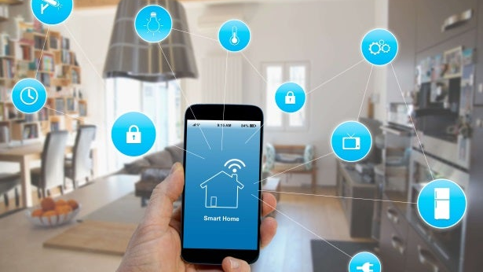
Outline
SOFTWARE ARCHITICTURE
FLOWCHART
PROTEUS SIMULATION

Slide 3
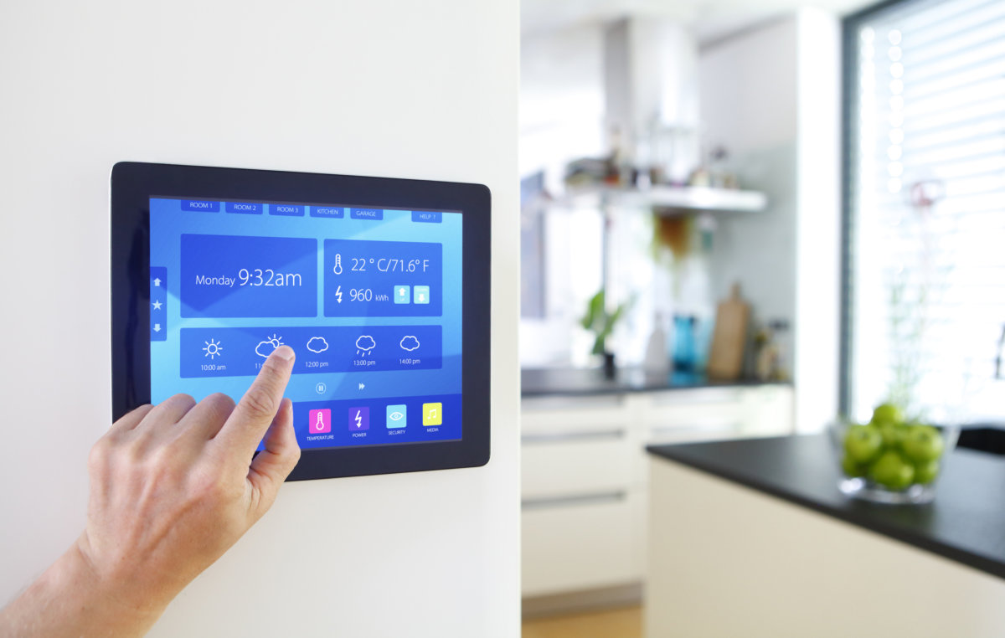
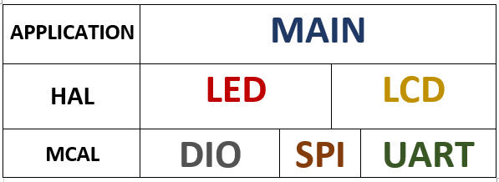
SOFTWARE ARCHITICTURE

Slide 4
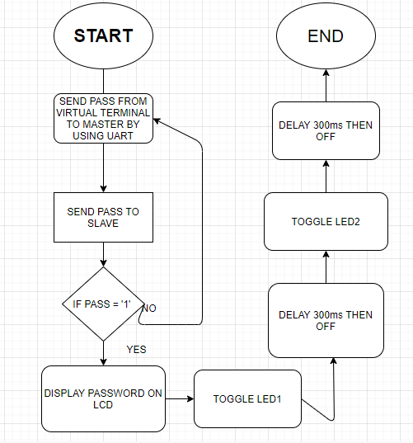
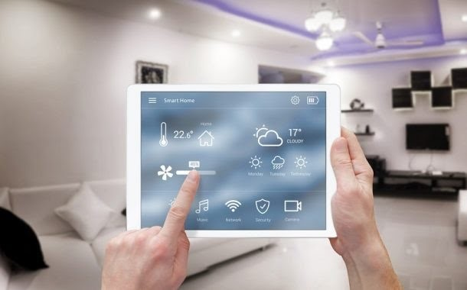
FLOWCHART

Slide 5
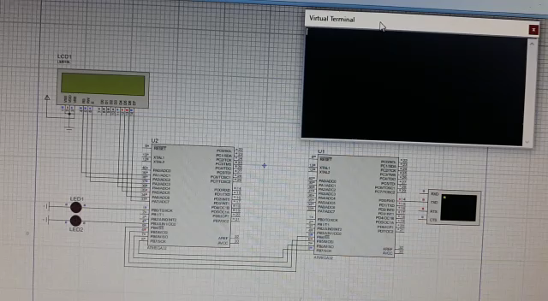
PROTEUS SIMULATION

